Slide 1
SECURE DATA HIDING IN IMAGES USING STEGANOGRAPHY
SECURE THE DATA TO PREVENT HACKERS
Presented By:
Student Name : P.SUMANTH (12001-14267-348)
College Name & Department : HINDUSTAN INSITITUTE OF TECHNOLOGY AND SCIENCE & B.TECH CSE CYBER

Slide 2
OUTLINE
Problem Statement
Technology used
Wow factor
End users
Result
Conclusion
Git-hub Link
Future scope

Slide 3
Problem Statement
There is a huge problem in conveying secret message which must not be identified by the unauthorized users espically in the sector of intelligence agencies, the military , business and so on

Slide 4
Technology used
Platform used:
python in windows
libraries used:
PIL Module

Slide 5
Wow factors
This project has a feature of modifying pixels of the image which makes the user more effective to work with this kind of encryption .
It is more user friendly and has cutting edge technological features implemented .

Slide 6
End users
Encryption and decryption methods are specifically used in sectors like finance, healthcare, government, technology, retail, and legal where sensitive data needs to be protected from unauthorized access, ensuring privacy and security during transmission and storage; this includes protecting financial transactions, patient records, classified information, and more.

Slide 7
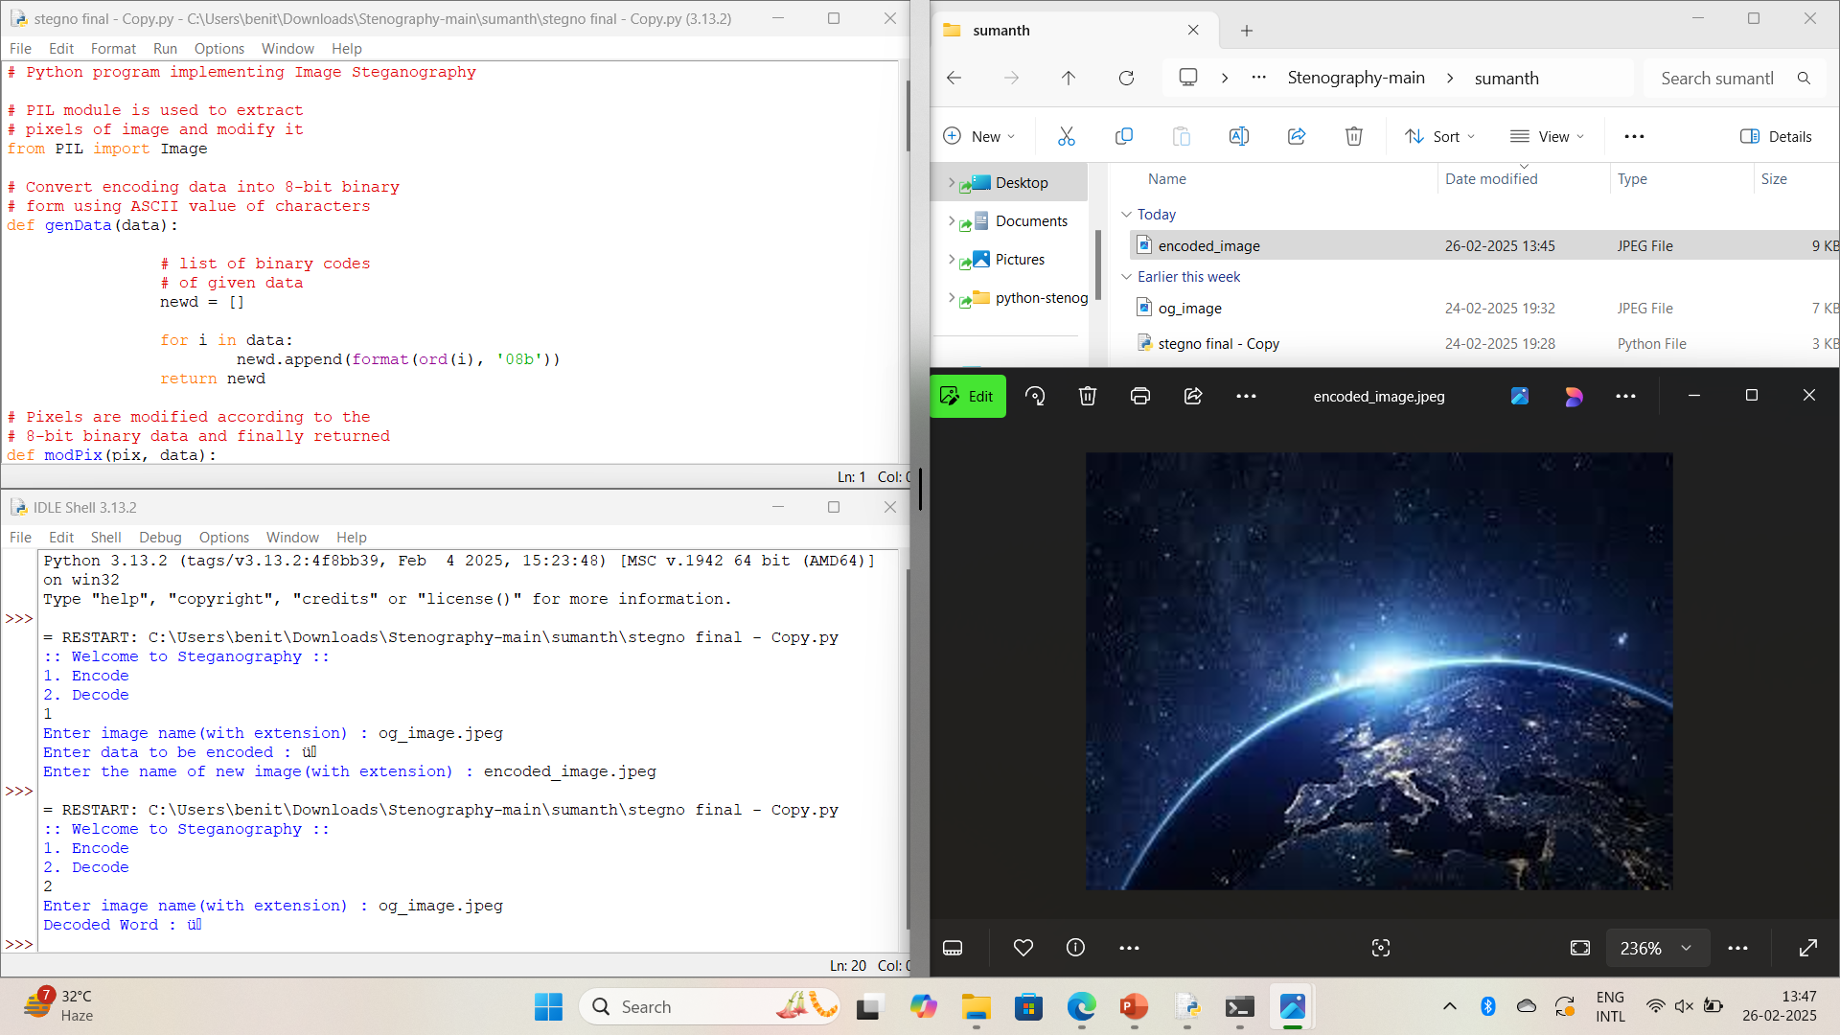
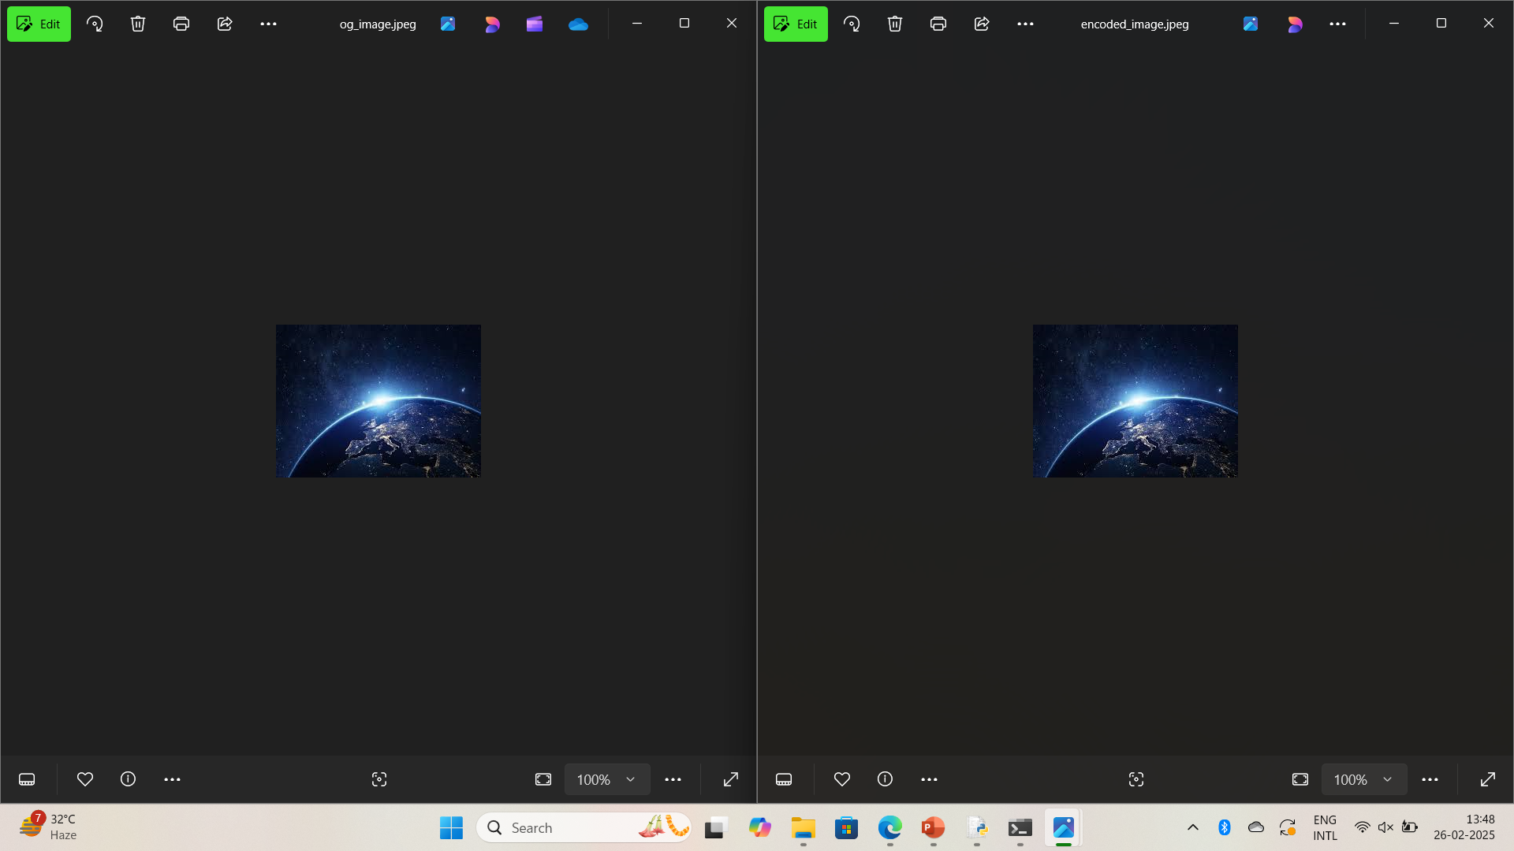
Results

Slide 8
Conclusion
Steganography can be used both for constructive and destructive purposes. For example, education and business institutions, intelligence agencies, the military, and certified ethical hackers use steganography to embed confidential messages and information in plain sight . which satisfies the problem statement .

Slide 9
GitHub Link
https://github.com/itssumanth/stegno_project.git

Slide 10
Future scope(optional)
The future scope of steganography lies in its potential for advanced secure communication across various fields, including digital watermarking, medical imaging, IoT security, and forensic investigations, by enabling covert data transmission within seemingly innocuous media like images, audio, and video, while maintaining high levels of data integrity and privacy.

Slide 11
THANK YOU

